Slide 1
Presentation to the Premier’s Literacy Advisory Panel
Dr Lisa Denny
Workforce Demographer
Adjunct Associate Professor, Institute for Social Change, University of Tasmania
Member of the Tasmanian 100% Literacy Alliance
30 November 2o22

Slide 2
Overview
Tasmanian 100% Literacy Alliance
Road Map to a Literate Tasmania – February 2021
Community-wide approach across the life stages
Submissions to inquiries and consultation processes
Government response
Target that all year 7 students start high school above the expected level for reading by no later than 2030
establishment of the Literacy Advisory Panel
10 year plan
Structured Literacy
Tiered approach
Scale and consistency
Prior performance
Literacy Advisory Panel
Terms of Reference
Education sector workforce
ITE, attraction and retention challenges, ageing workforce, skill shortages, population growth

Slide 3
Tasmanian 100% Literacy Alliance
Three recommendations:
1) Develop a strategic, whole-of-government, community-wide framework to achieve a Literate Tasmania, including implementation, ensuring evidence-aligned literacy instruction in Tasmania is scaled with a sense of urgency in a comprehensive and systematic way by multiple stakeholders.
This should be informed by an independent, expert advisory panel or Ministerial Taskforce (including whole-of-government, community wide stakeholders and leading experts from Tasmania and other jurisdictions) to:
Undertake a peer review of existing policies and programs to identify any evidence of practice gaps, and programme or skills gaps along with opportunities to redirect resources to more effective, impactful strategies;
Establish short- and medium-term measurable targets, aligned with the long-term goal for #100PercentLiteracy in Tasmania; and
Map existing organisations and resources to develop an integrated framework for a Literate Tasmania that links and leverages these strategies and resources.
2) Adopt and implement as an immediate priority the recommendations of the Primary Reading Pledge and invest in the resources (human and physical) and capacity building required to achieve the goal of close to zero Tasmanians starting grade 7 at or below the national minimum standard (NMS) for reading by 2031
3) Proactively support literacy improvement throughout the wider community, including in the early years (pre-school), secondary schooling, adult education, the justice system, and among other vulnerable Tasmanians, integrated into the plan for a Literate Tasmania. This is in addition to strategies that target primary-school-aged children, because #100PercentLiteracy is wider than schools alone.
Road Map to a Literate Tasmania – February 2021
Submissions:
The Federal Government Inquiry into Adult Literacy
Child and Youth Well-being Strategy
The Community Consultation phase of the Literacy Advisory Panel
The PAC Inquiry into the Tasmanian Government's continuing response to COVID-19
www.tasmanianliteracyalliance.org

Slide 4
10 year plan
Underpinned by four key factors:
Structured Literacy teaching practices
Tiered approach and intervention – RTI or MTSS
Scale and consistency
Prior achievement is correlated with future performance and predicts year 12 outcomes. This correlation is stronger than correlations with parental education or socio-economic background.
To achieve the target that all year 7 students start high school above the expected level by no later than 2030, it is critical that structured literacy practices are implemented with fidelity at scale.
2022 | Kindergarten | Oral language
2023 | Prep | Learn to Read
2024 | Grade 1 | Learn to Read
2025 | Grade 2 | Learn to Read
2026 | Grade 3 | Read to Learn
2027 | Grade 4 | Read to Learn
2028 | Grade 5 | Read to Learn
2029 | Grade 6 | Read to Learn
2030 | Grade 7 | Wider curriculum

Slide 5
Becoming literate
For 50% to 60% of students a structured literacy approach to reading, spelling and writing is ESSENTIAL
For 35% of students, facets of a structured literacy approach is important and valuable
For 5% to 10% of students, learning to read seems effortless

Slide 6
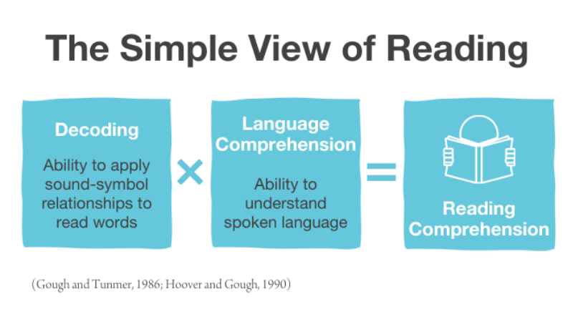
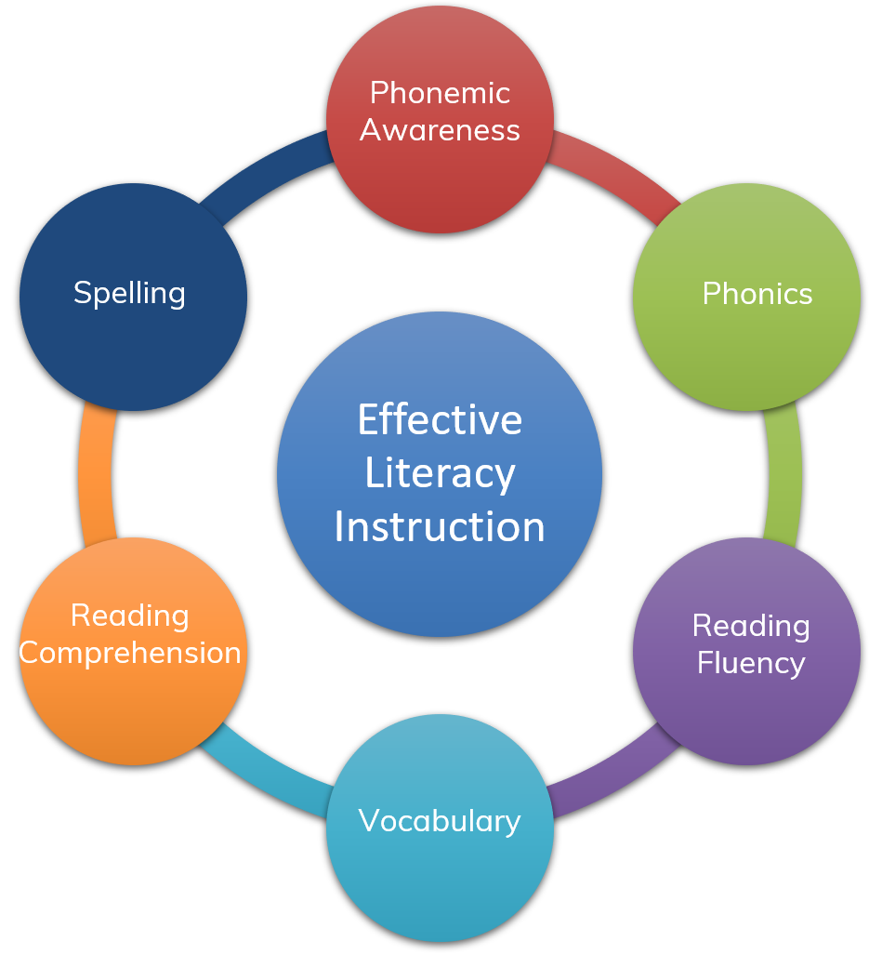
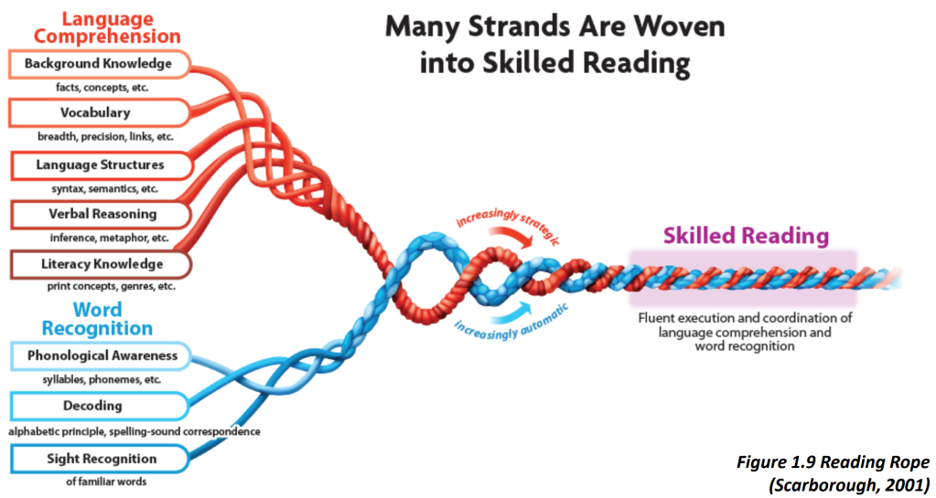
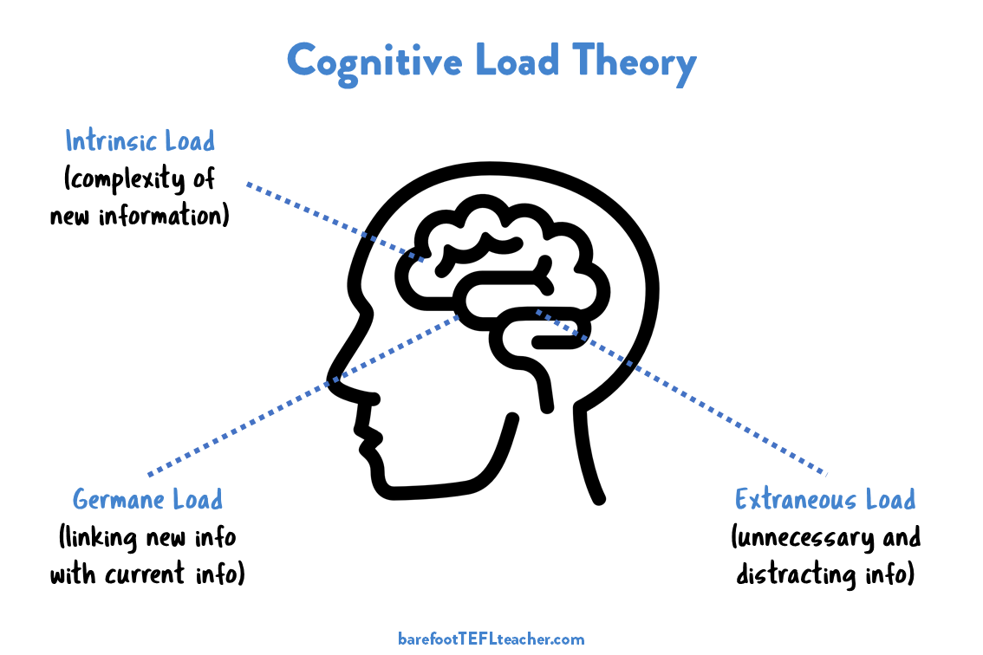
Structured literacy
The Big Six
Scarborough’s Reading Rope
An approach to teaching the structure of written text for reading and writing.
What (content)
Phonology
Orthography
Morphology
Syntax
Semantics
How
Explicit
Systematic
Sequential

Slide 7
Tiered approach
Response to Intervention:
Tier 1: whole class, structured literacy instruction
Tier 2: small group intensive intervention with aim to get back to Tier 1
Tier 3: specialised, individual support at intensity required
The Response to Intervention (RtI) approach acknowledges that even with high quality initial (Tier 1) instruction, a small number of children may need additional support through a small group (Tier 2) intervention, and an even smaller number may need specialised, individual support (Tier 3 intervention).
This non-categorical, child-centred approach ensures all students reach their reading potential.
To achieve the best possible literacy outcomes for all students, high fidelity implementation of structured literacy from Prep to Year 2 will provide the strongest results and enable all students to read to learn from grade 3.
If implemented at scale and with consistency, schools will have a significantly reduced need for Tier 2 intervention programs after about 4 years.

Slide 8
Scale and consistency matter - students

Slide 9
Scale and consistency matter - teachers
Survey of teachers who are on the structured literacy journey.
Driven by poor outcomes
No progress
Struggling readers
Intervention not working
Blind Adam could see too many students were struggling with basic literacy. – Classroom Teacher
I was shocked at my classes reading gaps and went looking for answers and stumbled across the Science of Reading – Classroom Teacher
20% of students in classrooms had dyslexia – Principal
Reading Recovery program not working, no evidence-based intervention – Principal
Feeling demoralised due to sense of helplessness for our students entering high school and already disengaged from their learning – School Leadership Team
Tracking data showed students were not making gains – School Leadership Team
I eventually decided to return and find out what was happening at the other end in primary. It led to me asking many questions about how to teach literacy and numeracy and teachers weren't able to give me an effective response. – School Leadership Team
Students were still struggling after intervention – Quality Teaching Coach
I knew it wasn't working and needed to find out why. – Learning Specialist
I began my SOL journey after realising that what and how I was teaching was not the most beneficial for both my students and myself – Classroom Teacher

Slide 10
Quest for Knowledge
Often accidental
Led me….
Stumbled across
Surfed the web
Went looking for answers
Find a better way
Opened my eyes
Seeking, hunting, exploring, investigating
Building knowledge
Deepening understanding
Journey of discovery
“After starting this role I quickly came to realise that my training had not equipped me to teach people to read.” – Classroom Teacher

Slide 11
Feeling alone
For the most part I was working rogue, not supported by leadership or a more skilled internal support. I paid for all of my own PL including LLLL, MSL, LDA and SOLLA. I have also joined every free thing I could get my hands on. I am really happy now with what I know and how I use it, but it has taken years and versions of my thinking to get here. – Literacy Coach
I was flailing; a brand new teacher in a very difficult school with no support. I tried what was out there, sight word bingo, dolch lists, all the stuff I could get for free. My DP told me my students weren't learning to read because "I didn't love them enough ". - Classroom Teacher
So, as an educator, learning about the science has transformed my delivery, but also left me feeling isolated among my peers. – Adult Education Teacher
The Principal at my substantive school has been the biggest barrier to successful implementation. I have since taken LWOP to attempt to find a school more open to change. – Classroom Teacher
After 3 years of teaching, I was starting to get some traction with systematic phonics instruction in my own classroom but still had to use PM assessments, which showed no progress – Classroom Teacher
It has been a challenge to learn, teach, lead and coach over the past few years but I am happy to make the effort and the positive and sustained outcomes for our students has made it worthwhile. – Learning Specialist
The experience has been frustrating as we had to convince our leadership team to adopt and be open to change. We have also had to do all our own PD in our own time. It has been wonderful seeing the growth of our kids, but as professionals we are putting in so much extra work in our own time to achieve this. – Classroom Teacher
I have spent most of my time outside of school and a lot of money in purchasing textbooks and professional development to upskill. It has been constantly draining to be told information at school and to know or discover the evidence against it out if school. – Classroom Teacher
It’s disheartening that next year my students will most likely go into Balanced Literacy and be given predictable texts. I worry about my students who are showing reading difficulties or have a Neurodiversity that impacts their learning, especially those who may fly under the radar. – Classroom Teacher
Anguish
On my own
Own time
Own resources
Lone Ranger
Black sheep
Working rogue
Operating under a cloak of darkness
Made to feel like an outcast
Isolated
Out of hours

Slide 12
Transformational experience
The experience has change me as a person and an educator - Principal
Brilliant. Challenging, exciting to see the progress in students and share, empowering because I know what to do to help students learn – School Leadership Team
Finding myself in the driving seat for the way in which my school would move forward in terms of teaching and learning coupled with the discovery of the Science of Reading ignited something that has turned into a huge passion. I was given the licence to read and research and read and research some more and then work out how I would take best practice to my staff- School Leadership Team
I was able to change my teaching practices and see results for my struggling readers. This made me want to learn more – Literacy Coach
We see that this is the 'way to go' to support ALL students – Learning Support
It's been overwhelming as well as exciting. I love feeling like I have ideas of how to help all children learn. – School Leadership Team
I had an opportunity to lead Literacy and with grit and a collective passion, my team and I began throwing research at the staff at our school. We met with resistance but we are still persevering – School Leadership Team
It’s been the most influential learning I’ve done in the 7 years I’ve taught – Classroom Teacher
I have loved my passion and purpose this new way of teaching has invigorated my 30 years of teaching. I decided to make a change and found a new school who wanted a teacher passionate about SOR. I have been thriving ever since. – Classroom Teacher
SoL has changed my teaching in so many ways for which I am forever grateful and appreciative.- Classroom Teacher
I specifically remember the moment I realised I had been in the wrong camp.- Ex-Reading-Recovery teacher now literary Teacher
Finding the Science of Reading/Learning has been pivotal in many educators’ careers
Turning point
Intellectual stimulation a driving force
Game changer
Overwhelming
Exciting
Sense of relief

Slide 13
What has happened since the Alliance Road Map?
Nationally:
New Australian Curriculum v 9.0
The Quality Initial Teacher Education Review
Standing Committee on Employment, Education and Training Inquiry into Adult Literacy
National Teacher Workforce Plan
Australian Education Research Organisation
PC Inquiry into the National School Reform Agenda
Tasmania:
Child and Youth Well-being Strategy
Youth Justice Blueprint
Globally:
COVID-19 pandemic

Slide 14
Community-wide Framework
All stages of life
Early years
Primary school
Secondary school
Higher ed/VET
Adult literacy
Youth justice system
Justice system
Disability education
Indigenous

Slide 15
Tasmanian 100% Literacy Alliance: Road Map to a Literate Tasmania | Tasmanian Government | Comment
Develop a strategic, whole-of-government, community-wide framework to achieve a Literate Tasmania, including implementation, ensuring evidence-aligned literacy instruction in Tasmania is scaled with a sense of urgency in a comprehensive and systematic way by multiple stakeholders ➢ informed by an independent, expert advisory panel or Ministerial Taskforce to: ▪ Undertake a peer review of existing policies and programs to identify any evidence-to-practice gaps, and programme or skills gaps along with opportunities to redirect resources to more effective, impactful strategies ▪ Establish short- and medium-term measurable targets, aligned with the long-term goal for #100PercentLiteracy in Tasmania ▪ Map existing organisations and resources to develop an integrated framework for a Literate Tasmania that links and leverages these strategies and resources. | Established a Literacy Advisory Panel Terms of Reference: Includes a review of the current literacy policies, approaches and supports in place in Tasmania in the early years, schools and adult learning environments Maps existing effort, including the organisations, plans and activity that currently support the establishment of a Literate Tasmania and identifies any gaps. These may include evidence-to-practice gaps, and/or program, cohort or skills-gaps. Considers the efficacy of existing literacy measures and targets. Makes specific and targeted recommendations to inform and build upon existing literacy approaches and supports in the early years, schools and adult learning environments. Draft framework due in October 2022 Final framework due in March 2023 | The Literacy Advisory Panel has consulted with the community to produce a list of the various initiatives and programs in Tasmania which may be associated with improving literacy outcomes These initiatives/programs have not been reviewed or mapped, nor their efficacy considered, to identify any evidence-to-practice gaps, and/or program, cohort or skills-gaps. NSW and SA are advancing their implementation of evidenced-based teaching practices. Victoria has announced the Y1 Phonics Check will be mandated from 2023. Yet to be done: Undertake a peer review of existing policies and programs to identify any evidence to practice gaps, and programme or skills gaps - Identify opportunities to redirect resources to more effective, impactful strategies and initiatives - Establish short- and medium-term measurable targets, aligned with the long-term goal for 100% Literacy in Tasmania
Adopt and implement as an immediate priority the recommendations of the Primary Reading Pledge and invest in the resources (human and physical) and capacity building required to achieve the goal of close to zero Tasmanians starting grade 7 at or below the national minimum standard (NMS) for reading by 2031 | Set a target that all Tasmanian grade 7 students will start the year above the expected standard for reading by no later than 2030 | Recommendation: Sign the Primary Reading Pledge Be the first state or territory to sign the Pledge Create a point of distinction/differential/edge Leverage the media and public interest to attract Science of Learning/Reading educators and support professionals to move to Tasmania

Slide 16
Why wouldn’t we do everything we possibly could to ensure a Literate Tasmania?
The Government has:
an aspiration for 100% ‘functional’ literacy
set a target within a timeframe
How do we do it?
Road Map to a Literate Tasmania
Primary Reading Pledge
Invest in a system-wide primary school improvement approach which provides a structured, evidence-based, guided and supported pathway to success.
You need to get it right in Primary School to improve educational attainment at year 12 and achieve life-long functional literacy.
Two stage, but concurrent, approach*:
Immediate term: invest heavily and intensively over four years in a co-designed system-wide solution to up/reskill all leaders, quality teaching coaches and primary school teachers and support staff in structured literacy practices including providing a low variance curriculum, pedagogy, resources and assessment processes.
e.g. South Australian Literacy Guarantee, Catalyst at Canberra Goulburn Catholic Education, EdVance, CogLearn, TeachWell, SOLAR Lab at Latrobe University, Edith Cowan University
Short term: build the capacity and capability of the internal system over 4 years and better integrate and optimise the value of allied health professionals (i.e. exit strategy from the immediate term phase)
*In this time, ensure that the Initial Teacher Education (ITE) course at the University is evidence-informed and provides pre-service teachers with the knowledge and skills for effective classroom implementation of structured literacy instruction

